Slide 1
1 dimensional fitting
Group meeting 10.07.2024

Slide 2
Different functions of cross section to fit
So far always fitted ln(cross section) with ln(p)
Now fitted cross section with p directly
Also tried out sigmoid, sigma/p,
Studied also microwave and optical frequencies and in general more frequencies

Slide 3
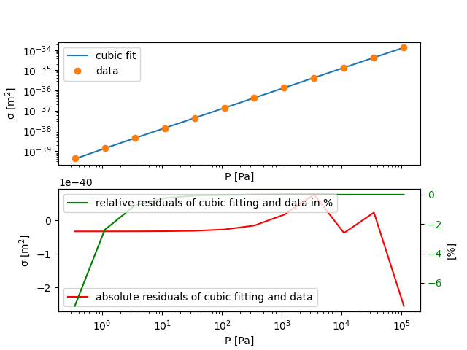
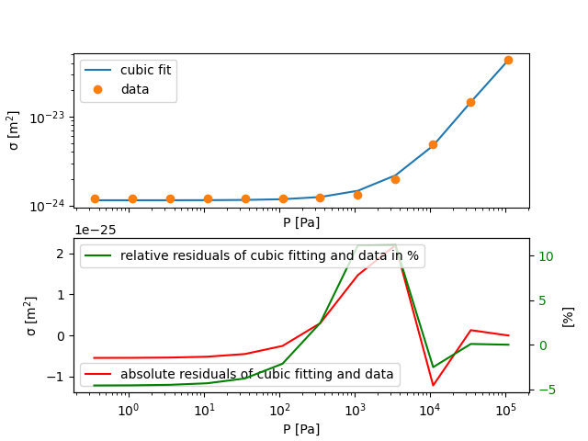
Fit cross section with pressure directly
CO2 at 109 cm⁻¹ at 240 K far away from absorption peaks (left)
Fitted cross section with cubic polynom with the pressure dependane for both
R² = 0.999999999995
But large relative deviation for ultralow pressures
CO₂ at 2340 cm⁻¹ at 240K at absorption peak (right)
R² =0.9994
Midfrequencies difficult to fit
Notes:
The large deviation for small pressures is here much larger than in the ln(sigme) function and fit

Slide 4
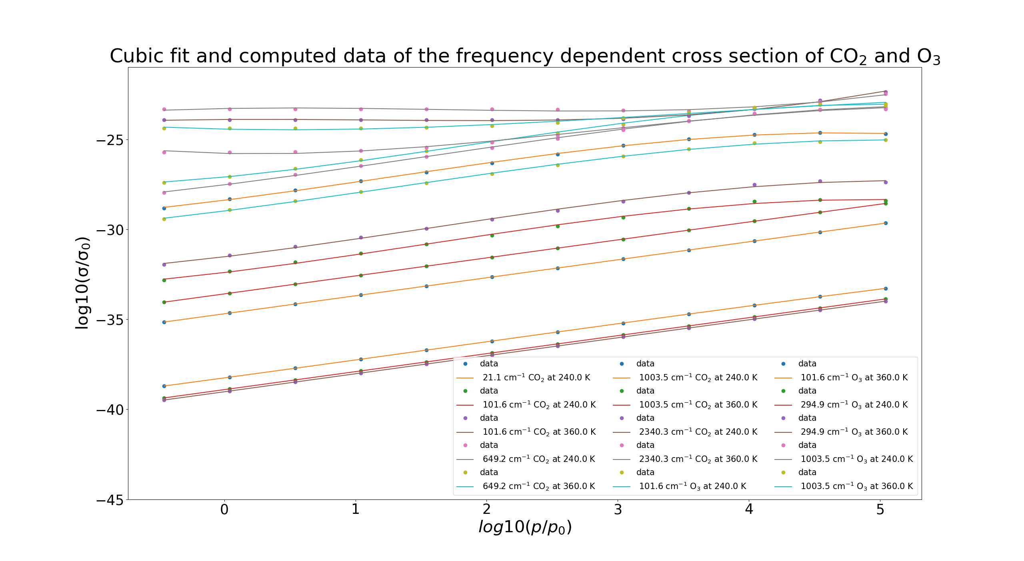
Cumulative plot: cross sections data and fit
Computation of ln(cross section)
Cubic fiting
For CO₂ and O₃
Different behaviour at peak wings and far away from absorption peak

Slide 5
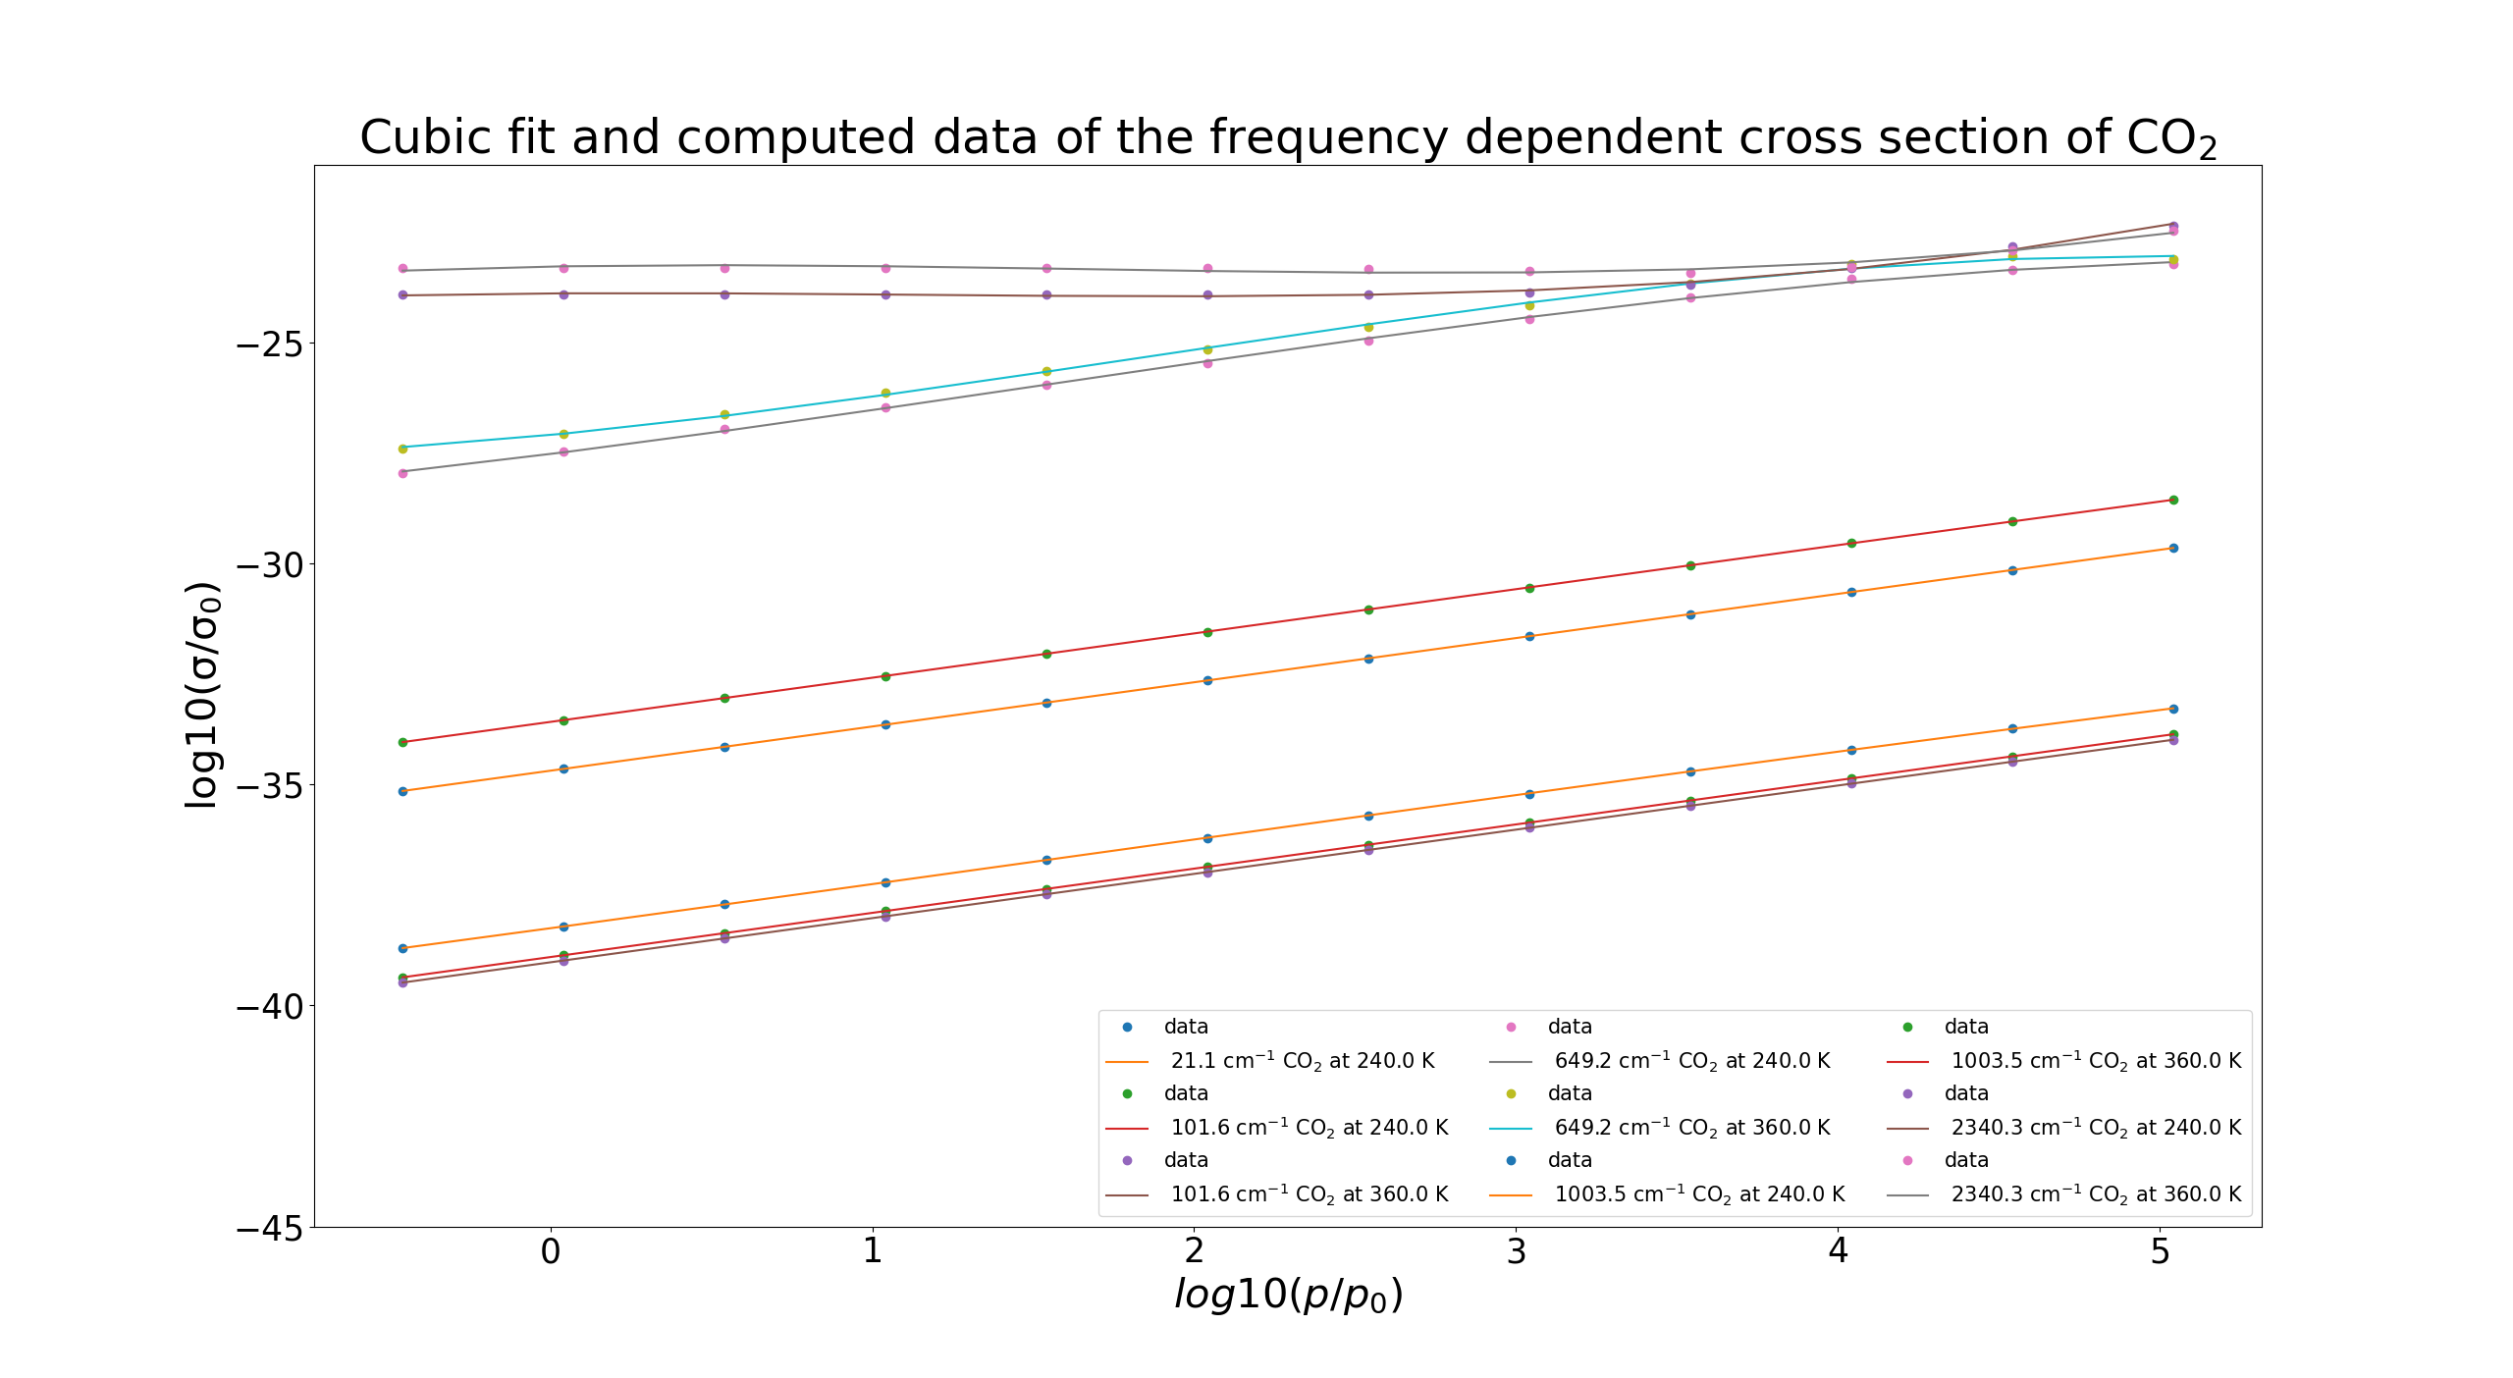
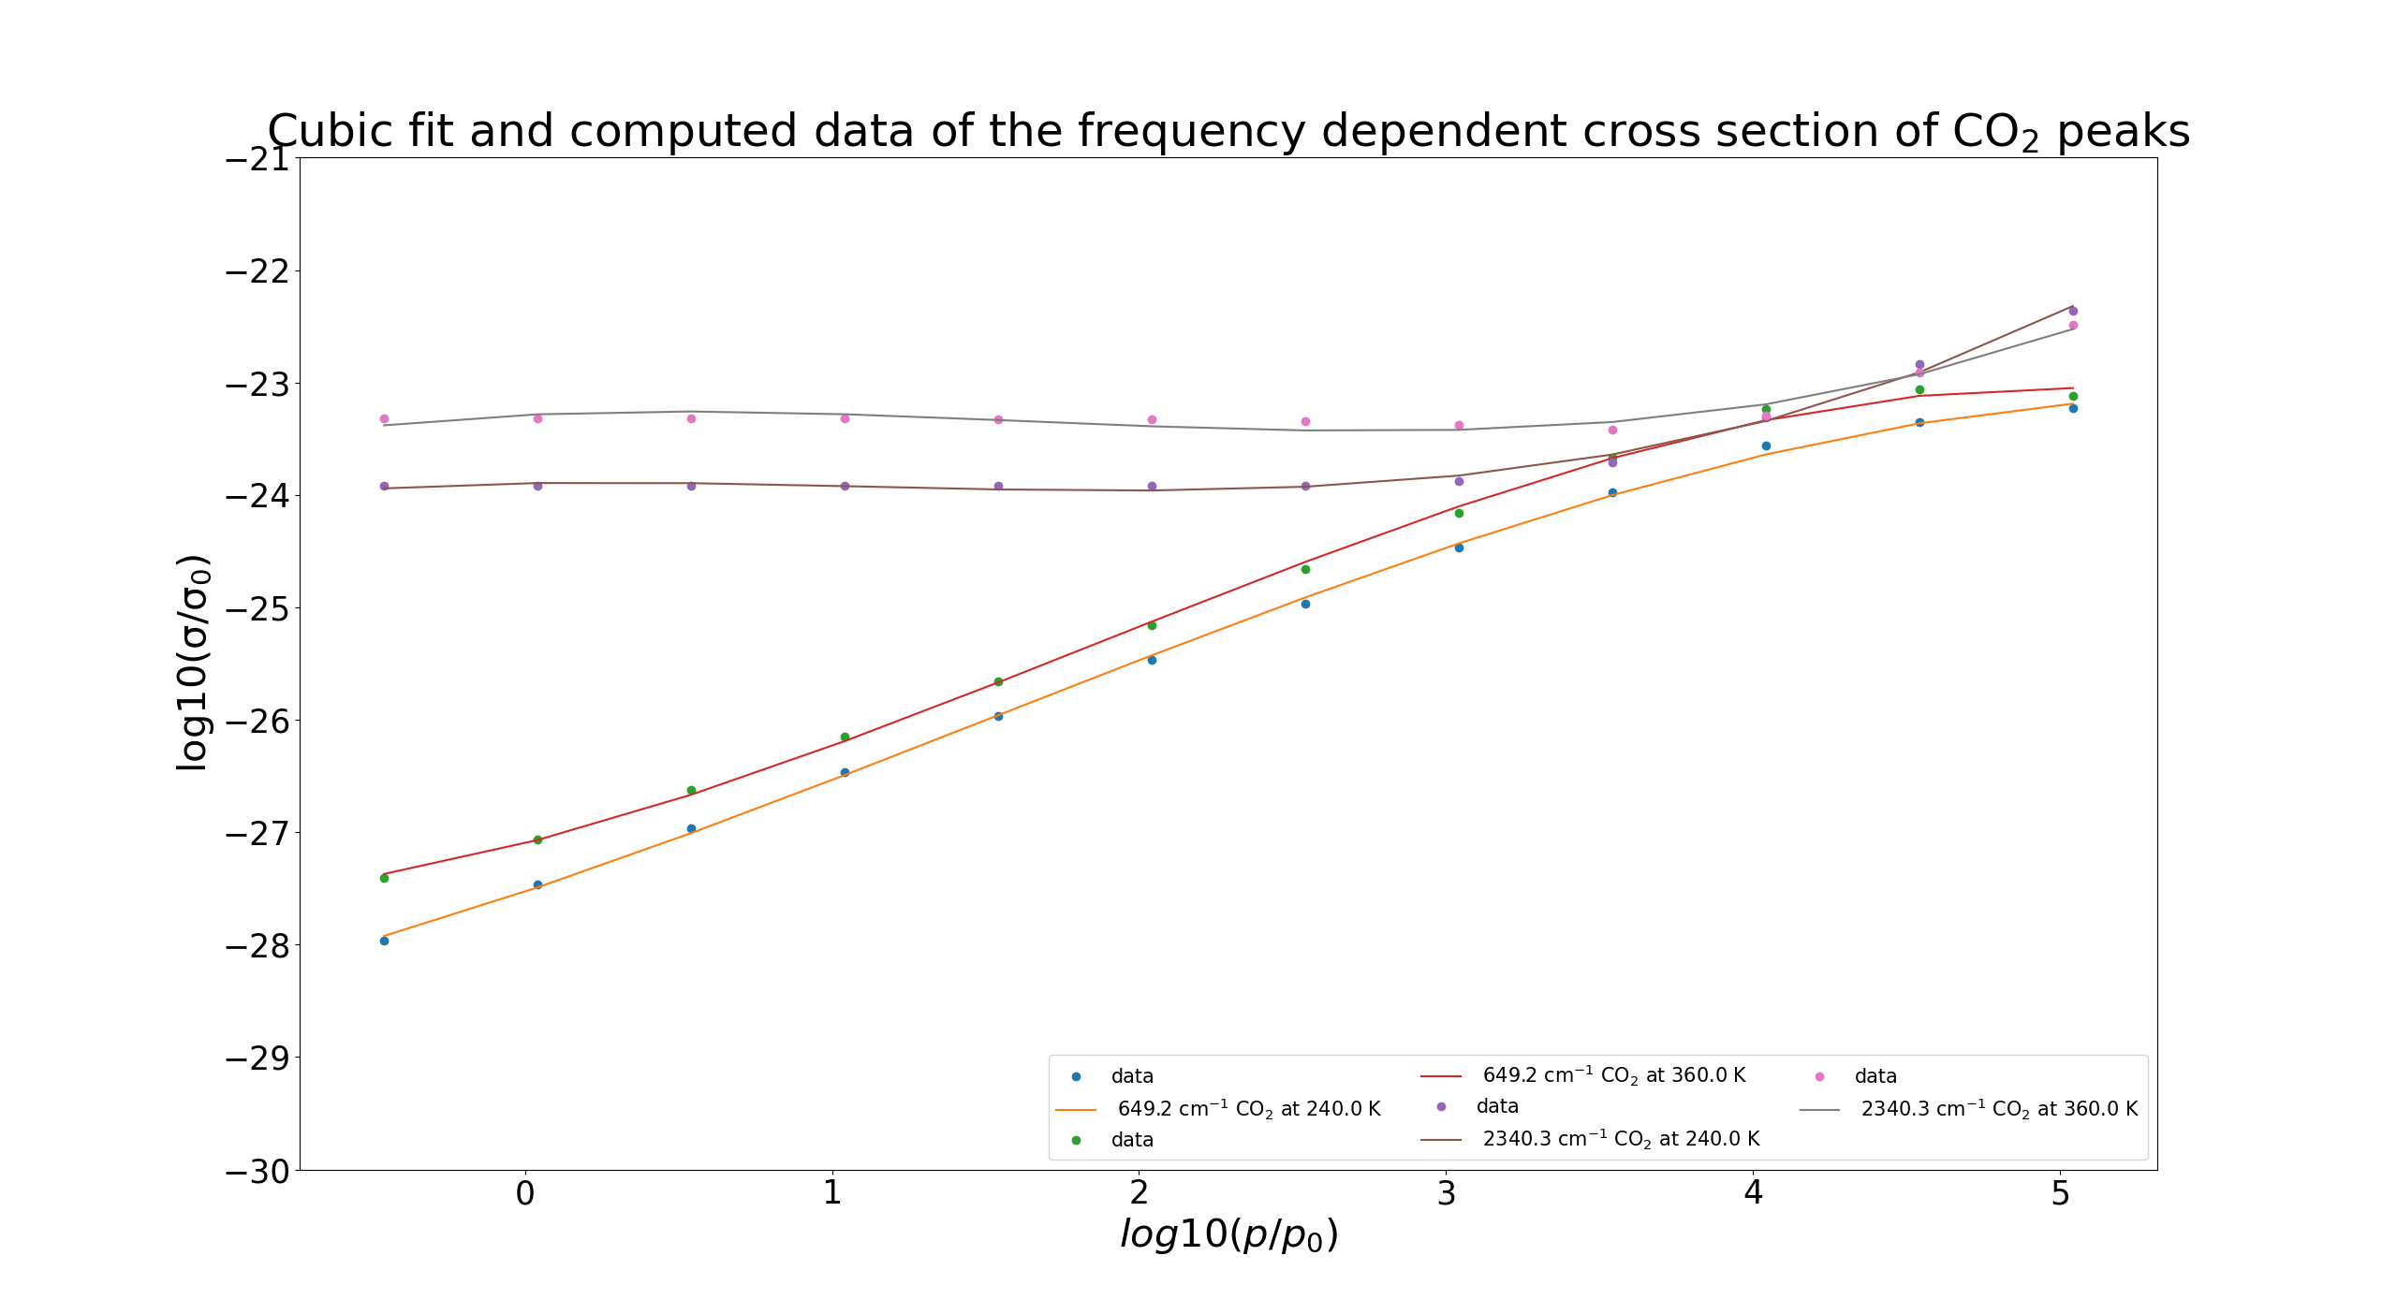
Cumulative plot: cross sections data and fit for CO₂
Same computation and cubic fit only for CO2
Picture below zoom into behaviour at absorptions peaks
Notes:
649 cm^(-1) and 2340 cm^(-1) are main absorption peaks
Higher temperature better absorption
Hypothesis: Does it come from stronger Doppler broadening but T is also included in formula for more dominant pressure broadening

Slide 6
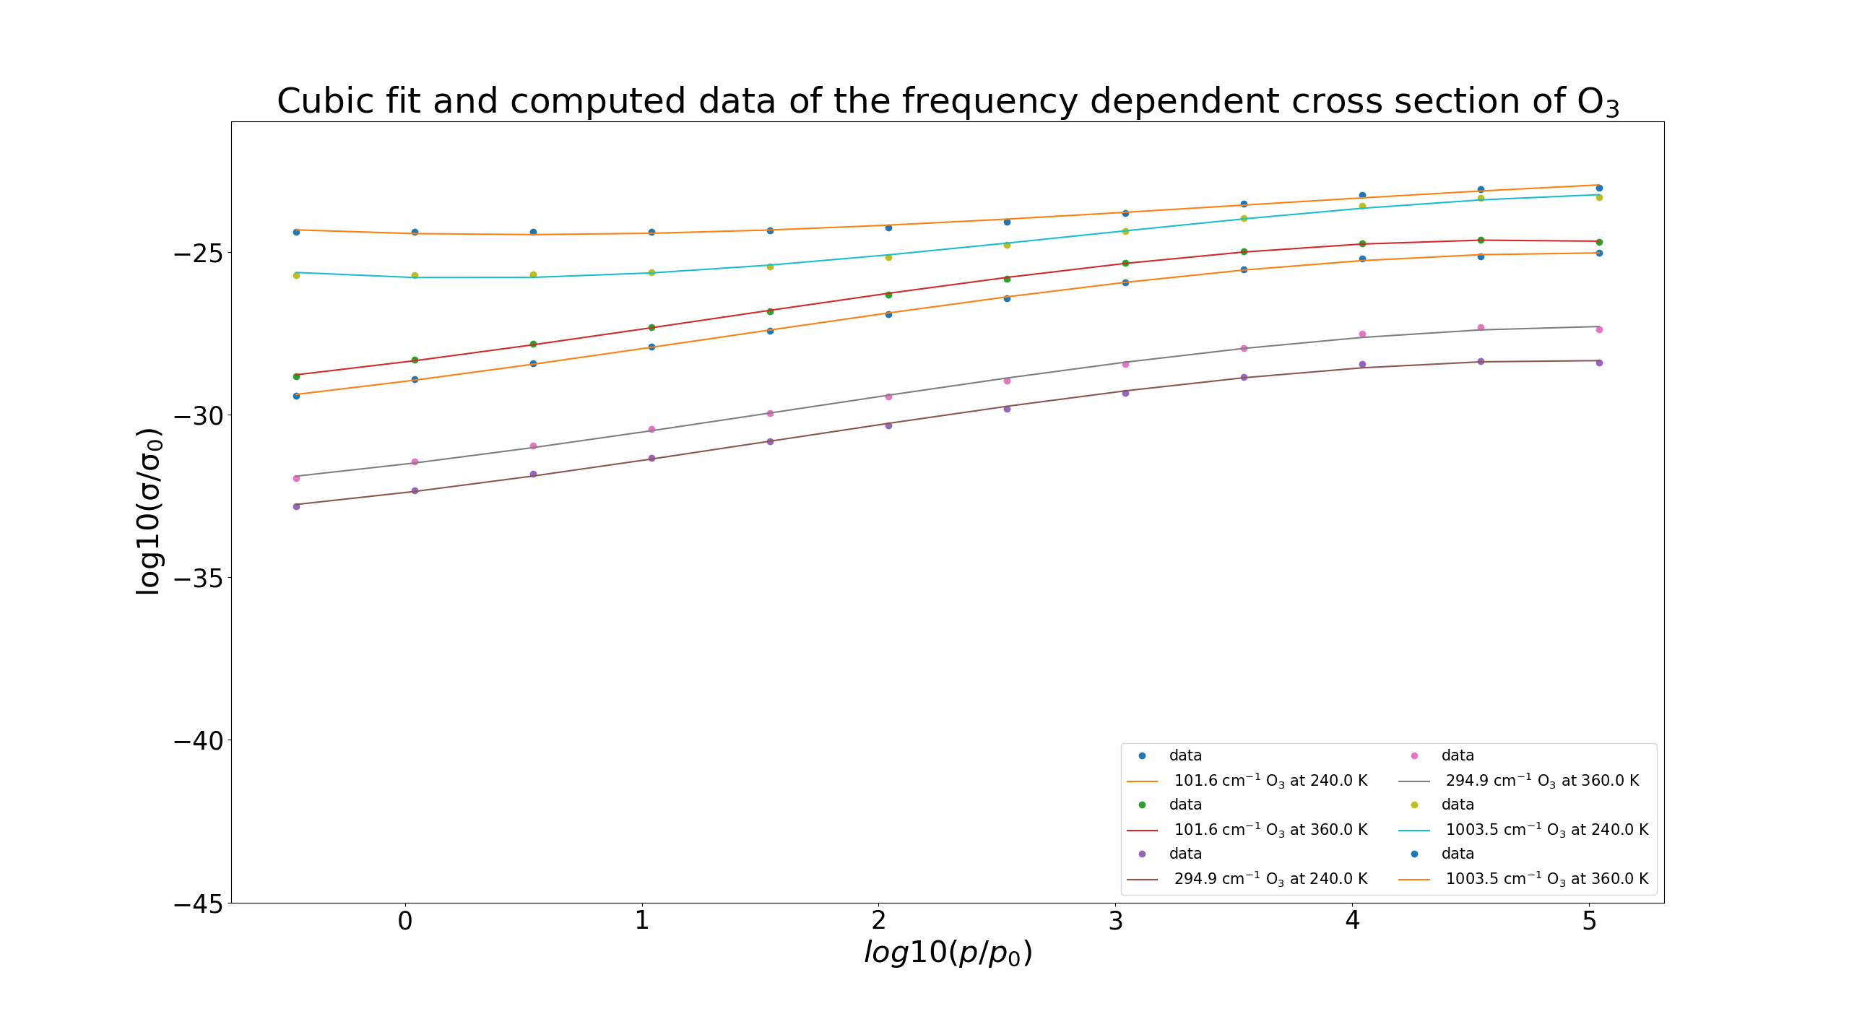
Cumulative plot: cross sections data and fit for O₃
Cubic fit of P-dependent O₃ cros sections
Less linear far away from peak than for CO₂
Notes:
Only 1003 cm^(-1) is an absorption peak of Ozone
First wrong idea: non linearity comes from Doppler et higher frequencies for ozone, but wrong because we see it already for lower frequencies

Slide 7
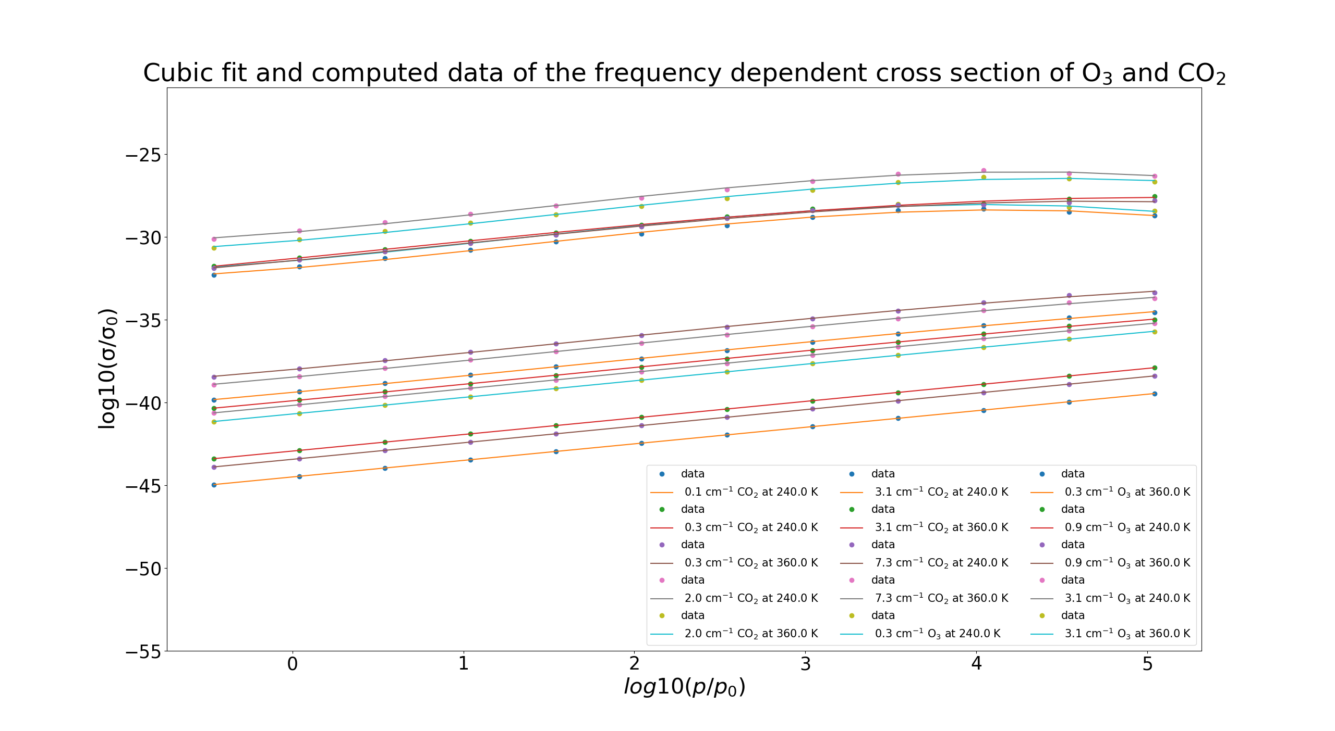
Cumulative plot: cross sections data and fit (microwave)
in general much weaker absorption in the microwave range
But general p dependency similar to infrared

Slide 8
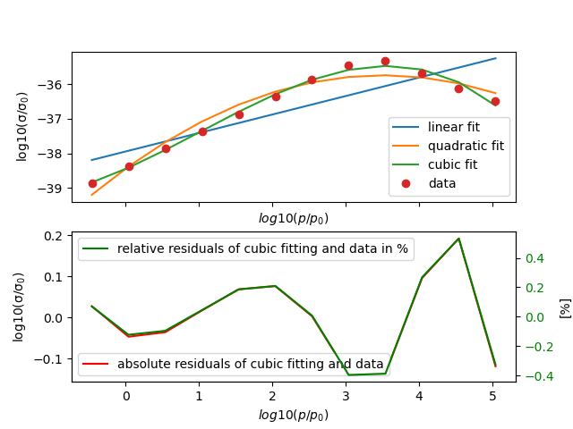
Absorption Peak in the microwave interval (CO₂)
Absorption peak at 0.75 cm⁻¹ at 240 K for CO₂
Similar fit quality as for peaks in infrared interval

Slide 9
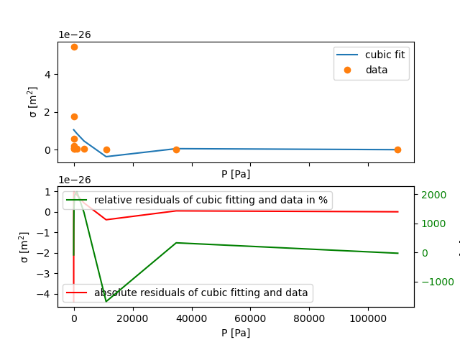
Try out sigma/p cubic fitting of cross section
1003 cm⁻¹ for O3 at 240 K
Cubic fiting doesn’t approximate at all
very large deviations

Slide 10
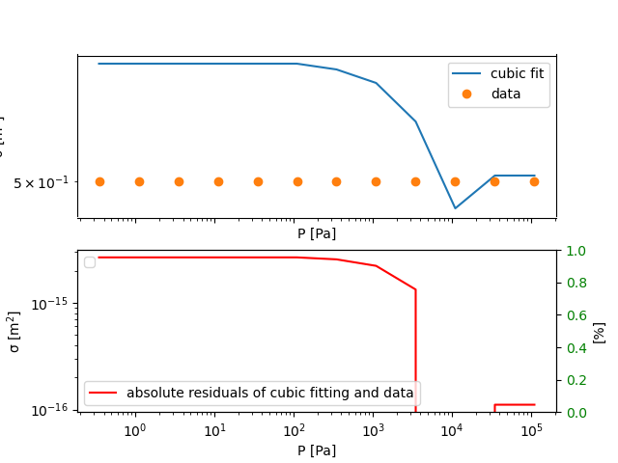
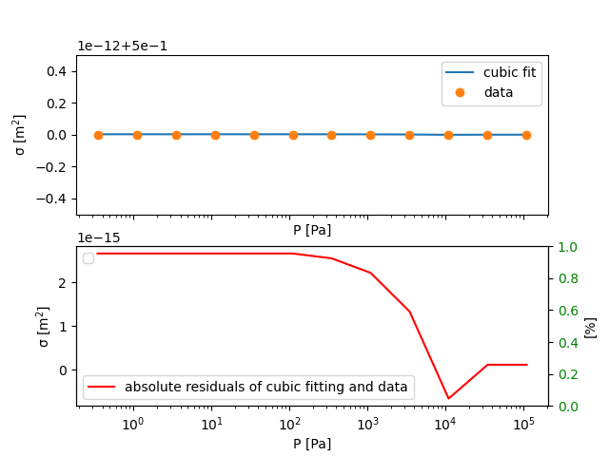
Try cubic fitting of sigmoid of cross section
1003 cm⁻¹ for O3 at 240 K
Cubic fiting doesn’t approximate at all it seems first
misleading impression: very small deviations between data and fit
Plot seems wrong but no implementation error found
Notes:
Fit computes 5. 000 000 000 0027

